Slide 1
ISCG8022 Managing it projects
Assignment two: star car rentals
By:
Dean Du Toit (1486879)
Chunkai Meng (1494933)
Simranjeet kaur Grewal (1494653)
Unitec Institute of Technology
Semester 2 2017

Slide 2


contents
The business problem
The solution
Cost and benefit (tangible and intangible)
The work breakdown structure
List of deliverables and their contents
Project team structure
High level project timeline
Risks and how these will be mitigated

Slide 3


The business problem
Star Car Rentals cloud based system has been lacking integration.
There have been a number of problems of incorrect information about vehicle availability, poor vehicle maintenance, incorrect invoicing etc.
Currently, the same data are input into multiple systems, we use batch files to manage these multiple data entries and update it at intervals to ensure the system can run up.
Notes:
During the last 10 year. we had ever been the leader of in car rentals industry.We won 45% of the total market share, we have more than 8 IT systems and subsystem to support our growing business.However, as the market grows the system is getting bigger and bigger our systems will not be able to support anymore.I'm sure everyone already knows the customer issues cause by our system failures.And how much we already pay for that.More than that we got extreme customer dissatisfactiona decline in revenueour market share fell to 20%.I want to let everybody here know. to handle the failures caused by the lack of integration and duplication of data.What we are doing now is enter the same data into the different system and using batch files to synchronize and update every subsystem at night.Yes, it works now, but it's inefficient and error-prone. This is not a good solution, it's not even a solution for a production system.Any software or hardware error happen during this process could cause data loss and so become a disaster. It's not merely about the system downtime or business interrupt.It could definitely ruin our future.So what we really need is a reliable, Scalable, high available total solution.

Slide 4

The solution
Implementation a new cloud based system within Star Car Rentals with the help of Alpha Rental Software (ARS).
Setting up a Business Case and convincing John Lambert and other executives to make necessary investments.
Notes:
ARS has been providing software and related service to a number of organisations whose business predominantly revolves around renting or lending,

Slide 5


Cost and benefit (tangible and intangible)

Slide 6
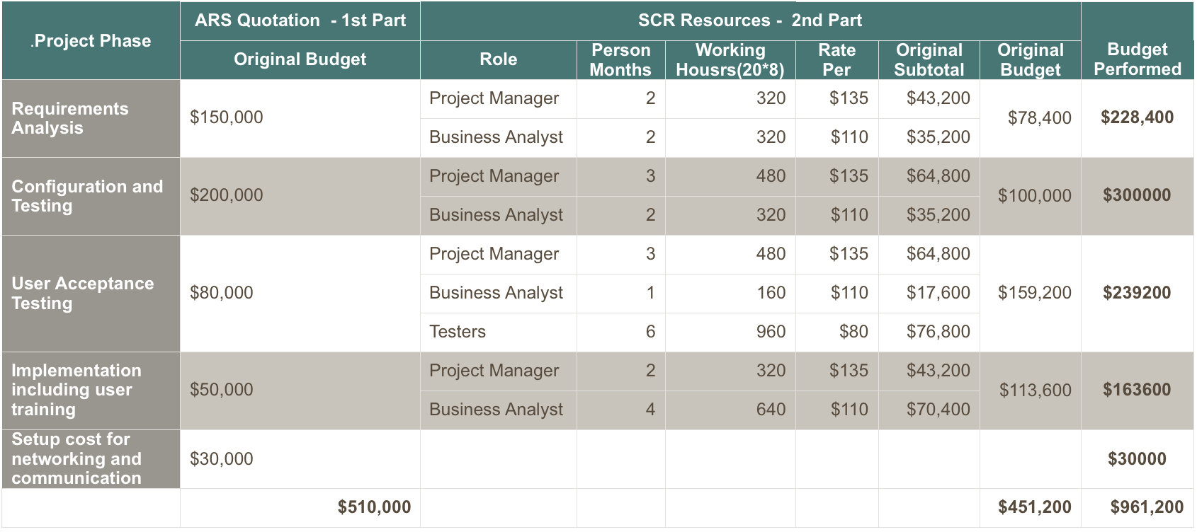
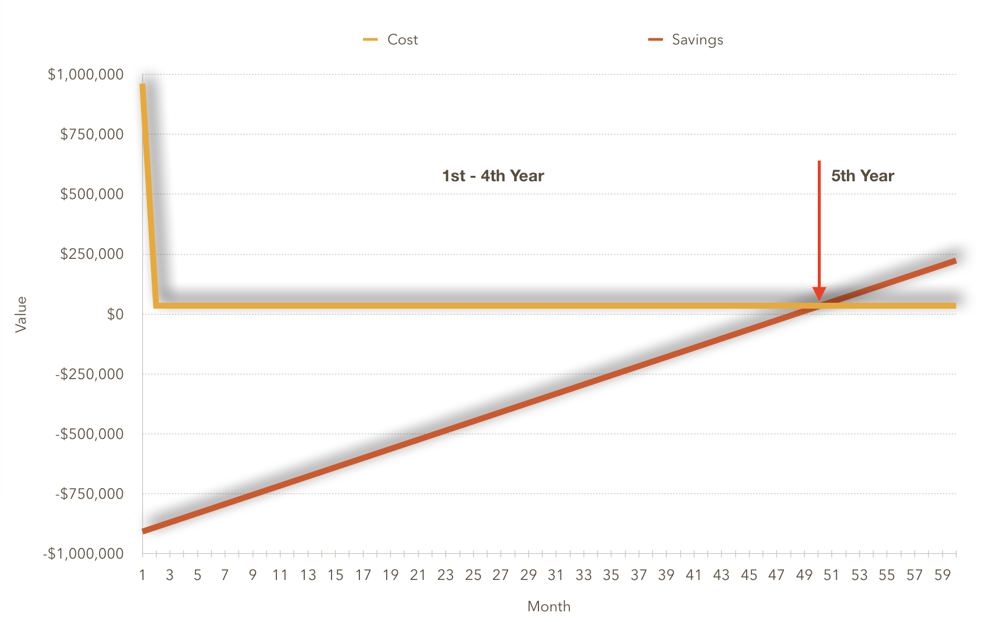
Cost
Savings

Slide 7

The work breakdown structure

Slide 8
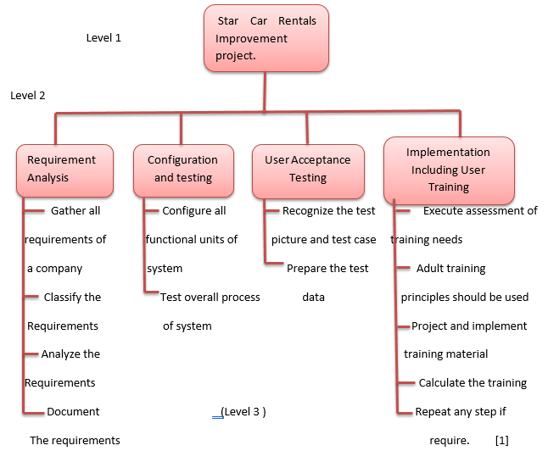

Slide 9

List of deliverables and their contents

Slide 10
Initial project plan
Project charter
Risk management
Requirement description document
Documentation of gap analysis
Customization specification
Specification of configuring the product
Report specification
Planning for testing of system and integration testing
Plan for training
Configuration and testing of modules of system
Integration testing system
User acceptance testing
Implementation plan
Traceability plan

Slide 11

Project team structure

Slide 12
John Lambert
CEO of Star Rental Cars
Project Manager
Sandra Hall (IT Manager)
Department Manager
Administration
Project Team
Alpha Rental Software (ARS)
Staff

Slide 13
High level project timeline

Slide 14

Risks and how these will be mitigated

Slide 15
New cloud system crashes
Executives may fail to support project
One major risk that can occur in this project is once the new cloud system has been implemented, this new system can crash or fail. To reduce of this risk happening certain steps are required to foreseen. An example of this is making sure to do a prototype version first. Prototyping is first testing out the system before applying the real system so testing out methods first is one important steps to see if errors will occur.
Project team may lack the authority to achieve project outcomes. In this case executives of Star Car Rentals support are fundamental. To stop this from occurring, it is important to make sure executives are part of this project and that they are supporting the project team through the entire project. Also making sure they are part of the decision making and communicating daily.

Slide 16
Stakeholder disagreement
Conflict between IT Manager and CEO
Conflict may arise between John Lambert CEO and Sandra Hall. Disagreements and poor decision can occur. To prevent this the CEO and IT Manager must be able to communicate well with each other. They must have excellent decision-making skills too. And lastly, making sure they have regular meetings always.
As mentioned before conflicts and disagreements can also occur between stakeholders. To prevent this, it is important to schedule meetings. This way stakeholders can gather together and discuss about the progress of the project. Staying in touch and committed is crucial for every stakeholder in this project.

Slide 17
Lack of skills
Poor communication
In every field it is important to require a certain number of skills. In this case, a project like this requires many skills between the stakeholders/people involved. However, some of those individuals may lack the skills necessary to complete this project. For some, it could be a new experience for them, for others they do not have the experience. To achieve this outcome, it is important to hire to proper people with the accurate set of skills. Also, these individuals must have experience.
Communication between stakeholders can become difficult sometimes. It can be hard to schedule weekly meetings, decision-making and organising. Stakeholders might loose interest and support the team. In order to prevent this risk from occurring on activity that can help is staying focus.

Slide 18
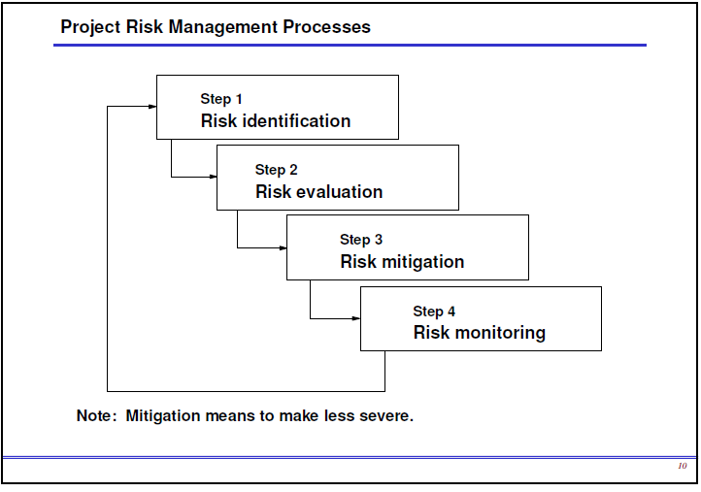
The key to communicating is to keep the receiver as the focal point not the sender. Try to think about what the receiver of the communication needs and the information that will be most helpful to them. If you are creating a progress report, put in all the information necessary for the reader to understand the true status of the project, including accomplishments, issues, risks, scope changes, etc.
When requiring resources in the future communicate proactively with the executives or project manager as early as possible. Keep reminding them of the need as deadlines gets closer. The project manager should also communicate clearly with their team. If you find people are confused about their end-dates or if they are doing work they don't need to do, think about whether you communicated to them effectively.

Slide 19

Questions?

